Slide 1
PROJECT ONE · ROUTING · WI-02
ESC soldering: motors, XT60, capacitor
STATUS
In progress — started 2026-09-21
NEEDS
WI-01 complete. Not the flight controller — it connects to the ESC by a plug-in cable, so none of these joints wait on it.
BATTERY
None in this WI. First power-up is WI-03, through the smoke stopper, after the pinout check.
TIME
~2 h 30 min across three operations — 14 joints total
WI-02 · ESC soldering: motors, XT60, capacitor
One slide per step · one photo · one check

Slide 2
Deck
1
Tools & parts on the bench
7
XT60 to the battery pads
Op 20
2
Trim, strip, and tin the motor wires
Op 10
8
Capacitor across the battery pads
Op 20
3
Tin the twelve ESC motor pads
Op 10
9
Shrink everything, no exposed copper
Op 20
4
Solder each motor wire to its pad
Op 10
10
Continuity audit
Op 30
5
Inspect: cone, no bridge, tug test
Op 10
11
End state
6
Heat shrink goes on first
Op 20
WI-02 · ESC soldering: motors, XT60, capacitor
11 slides

Slide 3
1
Tools & parts on the bench
ON THE BENCH BEFORE STARTING
PHOTO
01-tools-and-parts.jpg
• Iron with the largest chisel tip
• Solder (63/37), flux, wick
• Side cutters, wire strippers
• Heat shrink — sized for the motor wires and for the XT60 leads
• Helping-hands station with magnifier (from Day 3 on)
• ESC — Skystars KO60II
• XT60 pigtail (or the one from the ESC box)
• Capacitor — read the can: 1000 µF 35 V. The stripe side is negative. A 25 V cap blows on 6S.
• Safety glasses
CHECK the battery is in its bag, somewhere else. It does not come to the bench today.
WI-02 · ESC soldering: motors, XT60, capacitor
1 / 11

Slide 4
2
Trim, strip, and tin the motor wires
OP 10 · 20 MIN
DO — FOR ALL TWELVE MOTOR WIRES:
PHOTO
02-trim-strip-tin-wires.jpg
1. Cut at the tape mark from WI-01, slide 14.
2. Strip ~2 mm of insulation.
3. Flux the bare end and tin it — iron under, solder on top, until the strands wick full.
CHECK each tinned end is a smooth silver cylinder, not a blob, and no stray strands stick out.
WI-02 · ESC soldering: motors, XT60, capacitor
2 / 11

Slide 5
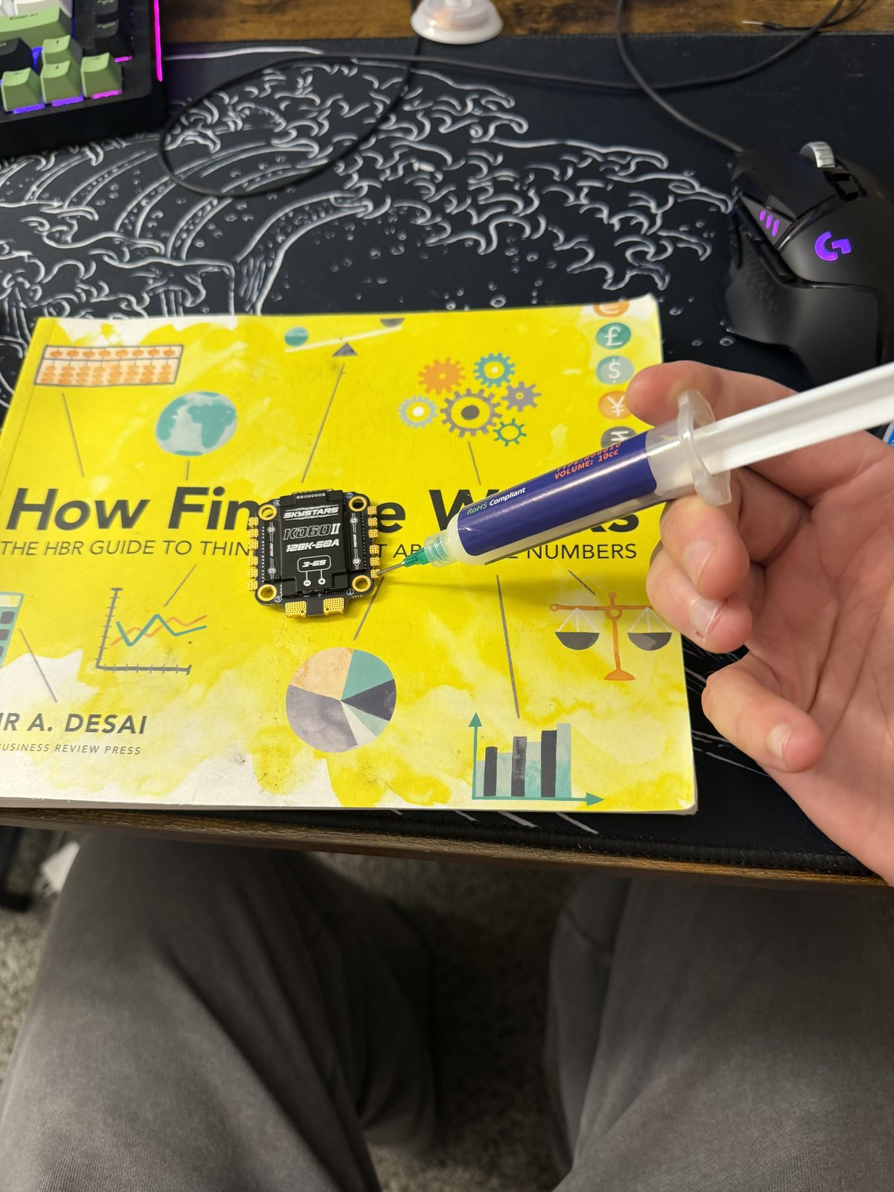
3
Tin the twelve ESC motor pads
OP 10 · 15 MIN
DO
1. Flux every motor pad.
2. Iron at 350–370 °C.
3. Put a small blob of solder on each pad — the pad should wet and the blob should sit domed, not spread.
CHECK twelve shiny domes, none touching a neighbor.
WI-02 · ESC soldering: motors, XT60, capacitor
3 / 11

Slide 6
4
Solder each motor wire to its pad
OP 10 · 45 MIN
DO — ONE JOINT AT A TIME, TWELVE TIMES:
PHOTO
04-solder-motor-wire.jpg
1. Lay the tinned wire on its pad.
2. Iron on pad and wire together.
3. Feed a little solder into the joint.
4. Hold still for 2 seconds after the iron lifts — moving a cooling joint makes a cold one.
Wire order within a corner doesn't matter — motor direction is fixed in software later.
CHECK the wire doesn't move when nudged, and the solder flowed onto both pad and wire.
WI-02 · ESC soldering: motors, XT60, capacitor
4 / 11

Slide 7
5
Inspect: cone, no bridge, tug test
OP 10 · 10 MIN
DO — UNDER THE MAGNIFIER, EVERY JOINT:
PHOTO
05-inspect-joints.jpg
1. Look for a shiny cone climbing from pad to wire.
2. Look between neighbors for any bridge.
3. Tug each wire, gently.
CHECK twelve shiny cones, no dull balls, no bridges, no movement. Any joint that fails gets wicked and redone — not reheated and hoped for.
WI-02 · ESC soldering: motors, XT60, capacitor
5 / 11

Slide 8
6
Heat shrink goes on first
OP 20 · 2 MIN
DO
PHOTO
06-heat-shrink-on-leads.jpg
1. Cut a length of heat shrink for each XT60 lead.
2. Slide both pieces onto the leads now, pushed well back from the ends.
CHECK two pieces of shrink on the leads before the iron gets near them. It cannot go on after the joint is made.
WI-02 · ESC soldering: motors, XT60, capacitor
6 / 11

Slide 9
7
XT60 to the battery pads
OP 20 · 25 MIN
CAUTION These are the two big joints. Max temperature (480 °C), largest tip, patience. Let the pad fully wet before feeding solder — 75 W needs a few extra seconds, not force.
PHOTO
07-xt60-battery-pads.jpg
DO
1. Tin the two big pads generously.
2. Red → +, black → −. Triple-check before the iron touches. Reversed polarity destroys the ESC instantly.
3. Tinned lead on tinned pad, iron on both, feed solder until it flows through, hold still to cool.
CHECK both leads solid, polarity confirmed against the ESC silkscreen a fourth time.
WI-02 · ESC soldering: motors, XT60, capacitor
7 / 11

Slide 10
8
Capacitor across the battery pads
OP 20 · 15 MIN
DO
PHOTO
08-capacitor.jpg
1. Trim the capacitor legs short — it sits close to the board.
2. Stripe to −. The stripe on the can marks the negative leg.
3. Solder each leg to the same battery pads as the XT60.
CHECK 1000 µF 35 V, stripe on the − pad, legs not touching anything else.
WI-02 · ESC soldering: motors, XT60, capacitor
8 / 11

Slide 11
9
Shrink everything, no exposed copper
OP 20 · 5 MIN
DO
PHOTO
09-shrink-done.jpg
1. Slide the shrink from slide 6 down over the XT60 joints.
2. Shrink it — iron barrel held near, rotate; or the lower half of a lighter flame, kept moving.
CHECK no exposed copper anywhere on the battery side of the ESC.
WI-02 · ESC soldering: motors, XT60, capacitor
9 / 11

Slide 12
10
Continuity audit
OP 30 · 20 MIN
CAUTION Multimeter on continuity. No battery anywhere near the bench.
PHOTO
10-continuity-audit.jpg
DO
1. XT60 + to −.
2. Each motor wire to its own pad, then to each neighbor pad.
3. + pad to every motor pad and to the frame; − pad likewise.
CHECK
✓ + to − reads OPEN. A brief blip while the capacitor charges is fine; a solid beep is a short — stop and find it.
✓ Every motor wire beeps to its own pad only.
✓ Neither battery pad beeps to any motor pad or to the frame (intended grounds excepted).
WI-02 · ESC soldering: motors, XT60, capacitor
10 / 11

Slide 13
11
End state
WI-02 IS DONE WHEN ALL OF THESE ARE TRUE:
PHOTO
11-end-state.jpg
• Twelve motor joints soldered, inspected, tug-tested
• XT60 on the battery pads, polarity confirmed, shrink over both joints
• 1000 µF 35 V capacitor across the pads, stripe to −
• Continuity audit passed — no shorts, no crossed pads
• The powertrain has still never been powered.
NEXT WI-03 — FC install, pinout check, first power through the smoke stopper. Unblocks when the SkyStars H743 lands.
WI-02 · ESC soldering: motors, XT60, capacitor
11 / 11

